Slide 1
File I/O
Static void Main( )
{
. . .
. . .
}
data

Slide 2
Topics
I/O Streams
Reading and Writing Text Files
Formatting Text Files
Handling Stream Errors
File Pointers

Slide 3
Objectives
After completing this topic, students should be able to:
Write programs that correctly read text data from a file,
handling file errors and end of file conditions appropriately.
Write programs that correctly format and write text data
to a file.

Slide 4
Stream Objects
We have been using stream objects all semester.
the standard input stream
the standard output stream
These streams are automatically created for you when
your program executes. We use methods in the Console
class to use these streams.
Console.WriteLine(“Hello”); //output stream
Console.ReadLine(); //input stream

Slide 5
To do file I/O, we will use a new
set of file I/O stream classes
StreamReader - objects of this class provide text file input
StreamWriter – objects of this class provide text file output

Slide 6
File I/O
When a program takes input from a file, we say that
it reads from the file.
When a program puts data into a file, we say that
it writes to the file.
To read or write to a file, we create a stream object,
and connect it to the file.

Slide 7
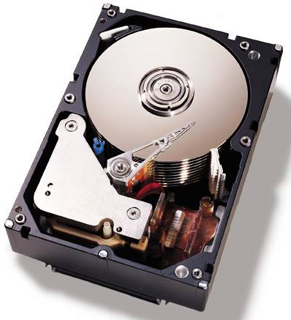
The disk drive is a mechanical device
so it operates at a much slower
speed than the computer’s processor
seek time is the time
required for the read head to
move to the track containing
the data to be read.

Slide 8
rotational delay or
latency, is the time
required for the sector
to move under the
read head.

Slide 9
Because it is a mechanical device,
the disk drive is also subject to
many more errors than the computer’s
processor.

Slide 10
Text Files
Data in a file can either be text or binary.
Everything in a text file appears as readable
characters. You can look at the file with a text
editor, such as notepad.
Text files are sometimes referred to as Formatted files.
This semester we will only deal with text files.

Slide 11
The StreamReader class
We use objects of the StreamReader class to
read data from a file.
To use the StreamReader class we have to write
using System.IO;
at the beginning of our program.

Slide 12
Creating A StreamReader object
StreamReader myData = new StreamReader(“theFile.txt”);
“theFile.txt” is the path to the file in the current directory
“C:\\theFile.txt” will access the file at the root of the C: partition
or use the fully qualified path
“partition:\\directory\\...\\filename.txt”

Slide 13
StreamReader Methods
The StreamReader class contains the ReadLine( )
method, which works exactly like its counterpart
in the Console class.

Slide 14
Example Code
StreamReader fileData = new StreamReader(“thefile.txt”);
string s = “”;
int num1 = 0;
double num2 = 0.0;
s = fileData.ReadLine( );
num1 = int.Parse(fileData.ReadLine( ) );
num2 = double.Parse(fileData.ReadLine( ) );

Slide 15
The StreamWriter class
We use objects of the StreamWriter class to
write data to a file.
To use the StreamWriter class we also have to write
using System.IO;
at the beginning of our program.

Slide 16
Creating A StreamWriter object
StreamWriter myData = new StreamWriter(“theFile.txt”);

Slide 17
StreamWriter Methods
The StreamWriter class contains the Write( ) and
WriteLine( ) methods, which works exactly like their
counterparts in the Console class.

Slide 18
Example Code
StreamWriter fileData = new StreamWriter(“thefile.txt”);
string name = “John”;
int age = 32;
fileData.WriteLine(“My name is {0}”, name);
fileData.WriteLine(“I am {0} years old.”, age);

Slide 19
Stream variables
In the statement
StreamReader theData = new StreamReader(“myFile.txt”);
The variable theData is a reference variable. It “points” to
the stream object that this statement created.

Slide 20
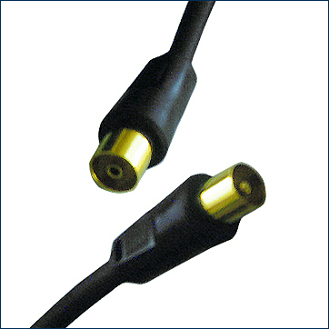
Connecting a Stream to a File
StreamReader inputStream = new StreamReader(“theData.txt”);
stream
object
program
theData.txt
Widget 123V89001 12.95
inputStream

Slide 21
Paths
StreamReader inputStream = new StreamReader(“theData.txt”);
if no path is specified, the file is assumed to be in
the same directory as the executable file.

Slide 22
Paths
StreamReader inputStream = new StreamReader(“c:\\theData.txt”);
When you code a \ in a pathname, you must
write \\. Why?
You can also use either of the following techniques
To show the pathname:
StreamReader inputStream = new StreamReader(“c:/theData.txt”);
StreamReader inputStream = new StreamReader(@“c:\theData.txt”);

Slide 23
Opening an Output file
If the named file does not exist, the file is created.
If the named file already exists, it is opened, and
the contents of the file are discarded, by default.

Slide 24
Formatting the Output
Most of the time, when we write data to a file, it is
with the idea in mind that the data will be read in
from this or some other program.
It is up to the programmer to format the data in the
output file, so that it can later be read in a meaningful
way.

Slide 25
Example
int a = 5;
int b = 15;
int c = 239;
StreamWriter output = new StreamWriter(“data.txt”);
output.Write(“{0}{1}{2}”, a, b, c);
515239
What happens when you try to read this file?

Slide 26
Writing a loop that reads until end of file
When we read data from a file, most often we have
no idea how much data there is in the file. So, we
need a scheme that let’s us continue reading and
processing data until we reach the end of the file.

Slide 27
If we have reached the end of the file, the ReadLine( )
method returns an empty string. This condition can be
tested with a statement like:
if (inputString != null) …

Slide 28
Activity Diagram
Read a line
of data into
a string
string is null
done
Process
the data

Slide 29
string theData;
StreamReader myFile = new StreamReader(“data.txt”);
do
{
Start the read loop

Slide 30
string theData;
StreamReader myFile = new StreamReader(“data.txt”);
do
{
theData = myFile.ReadLine( );
//Read some data

Slide 31
string theData;
StreamReader myFile = new StreamReader(“data.txt”);
do
{
theData = myFile.ReadLine( );
if (theData != null)
{
//Is the input null?

Slide 32
string theData;
StreamReader myFile = new StreamReader(“data.txt”);
do
{
theData = myFile.ReadLine( );
if (theData != null)
{
// process the data just read
}

Slide 33
string theData;
StreamReader myFile = new StreamReader(“data.txt”);
do
{
theData = myFile.ReadLine( );
if (theData != null)
{
// process the data just read
}
} while (theData != null);
//Loop until the input is null

Slide 34
Binary I/O
We will not do any binary I/O programs in this course.
Data is written to the output device exactly as it
Is stored in memory via a byte by byte copy.
Binary I/O is done using the BinaryWriter class.

Slide 35
Practice
Write a program for the diving competition at the Olympic games.
In the diving competition, each dive is scored by a panel of judges.
The scores are totaled and the highest and lowest scores are then
subtracted from the total. The average is computed for the remaining
scores. This is the score awarded for the dive.
Given: You have a file of judge’s scores in your documents
folder. The name of the file is given by the user.
The file is a text file. You do not know how many
scores are in the file, but it is less than 9.
Each score is a real number between 0 and 10,
e.g. 8.85

